Slide 1
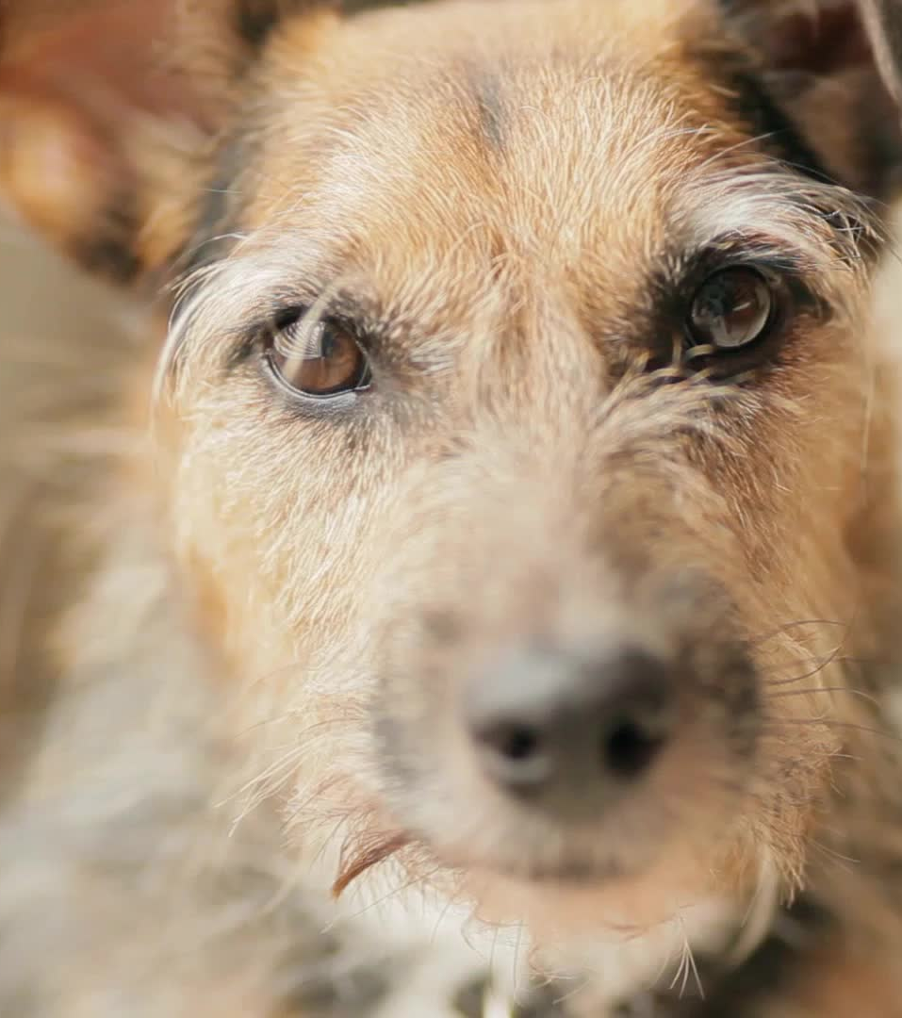
Ancient Dogs Dataset Analysis
By: Diego A. Rodriguez Moreno

Slide 2
Contents
The Dataset
Ancient Dogs Dataset
Sample Dataset
The Analysis
What is the objective?
Resources and Tools
The Results
A Glimpse at the results
The Conclusion
Final Notes

Slide 3
The Dataset

Slide 4
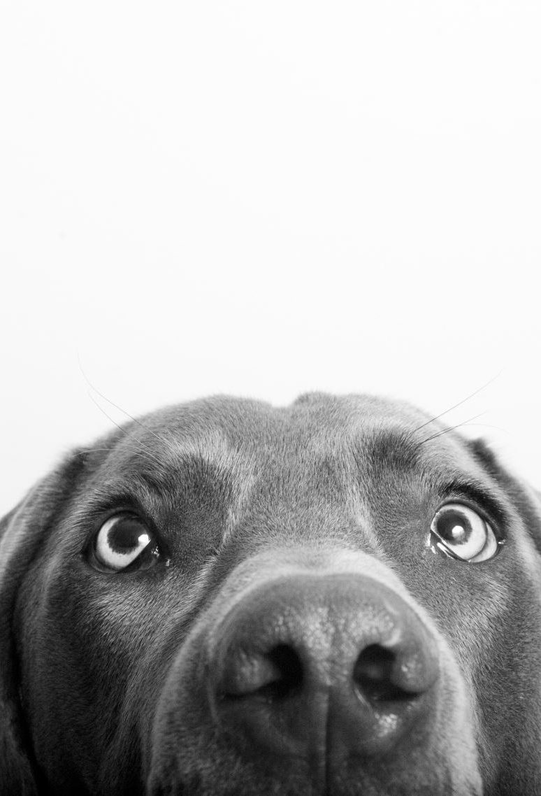
Ancient Dogs Dataset
The Ancient Dogs dataset is composed of2 datasets. the mean mandible measurements for seven canine groups. And the individual measurements including the sex of the dog.
Measurements from prehistoric dogs were found in northeast Thailand.
X1 = breadth of mandible, X2 = height of mandible below the first molar, X3 = length of the first molar, X4 = breadth of the first molar, X5 = length from first to third molar inclusive, and X6 = length from first to fourth premolar inclusive (all in millimeters).
Source: Data from Higham, C.F.W. et al., J. Archaeol. Sci., 7, 149–65, 1980.

Slide 5
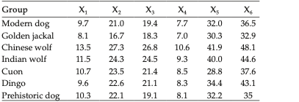
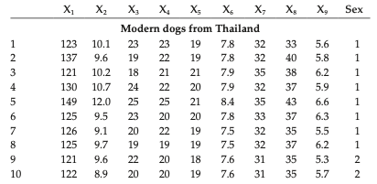
A Glimpse of the Dataset
Here we can see the datasets.

Slide 6
The Analysis

Slide 7
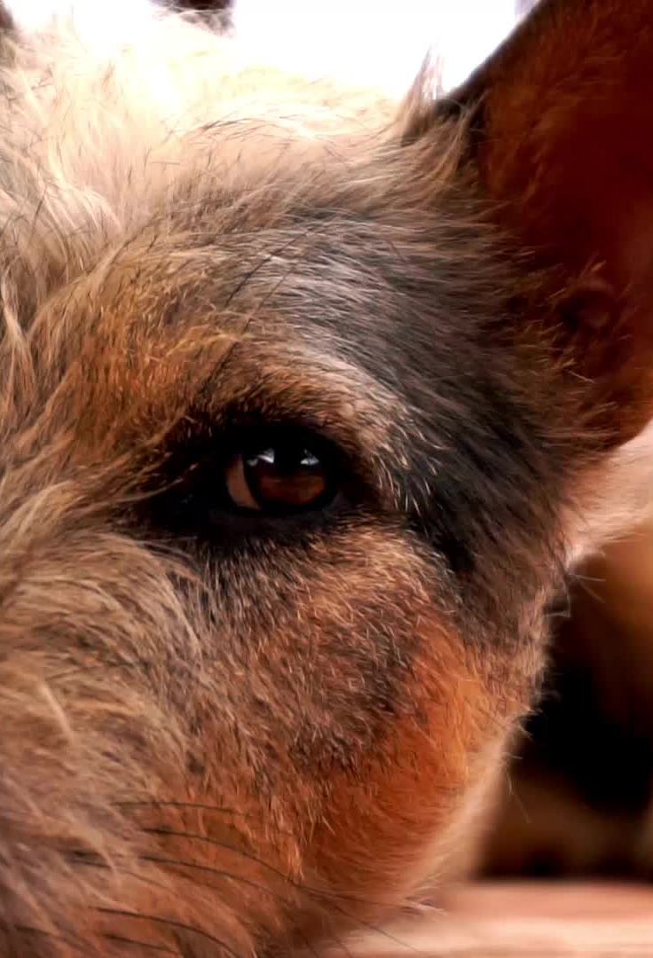
Objective.
We want to statistically determine which canine group is the closest related to the prehistoric dog.
We might infer based on the analysis where the origin of the prehistoric dog comes from.

Slide 8

Tools and Software
All the analysis will be performed using R Studio with minimal use of external packages.

Slide 9
Results

Slide 10
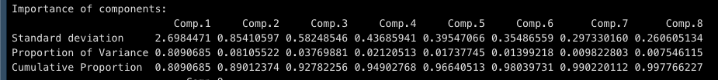
Principal Components Analysis
Based on the principal components analysis on the complete dataset, we only need to compare the data by 1 component.

Slide 11
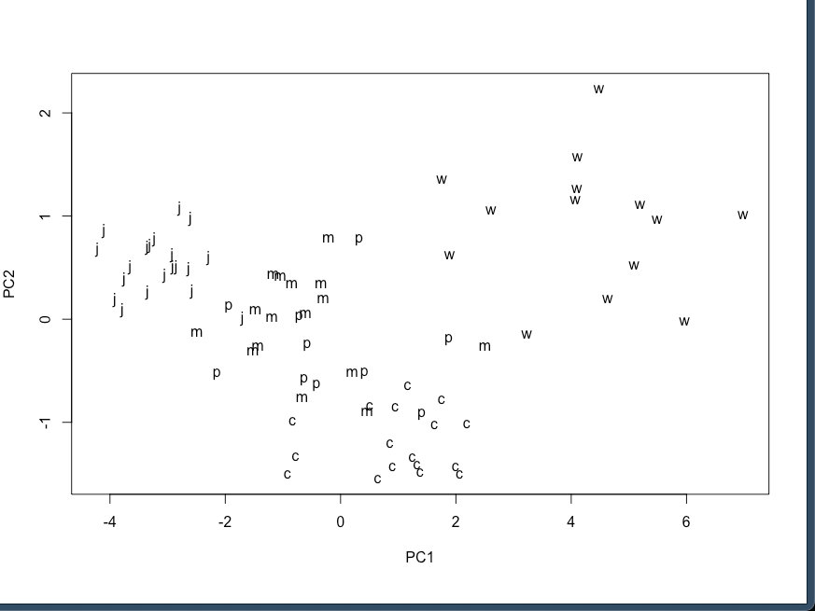
Comparing principal components
Here, we can see how the different species are grouped.
We can see how the modern ‘m’ dog is grouped really close with the prehistoric dog.
Now we should do a cluster analysis.

Slide 12
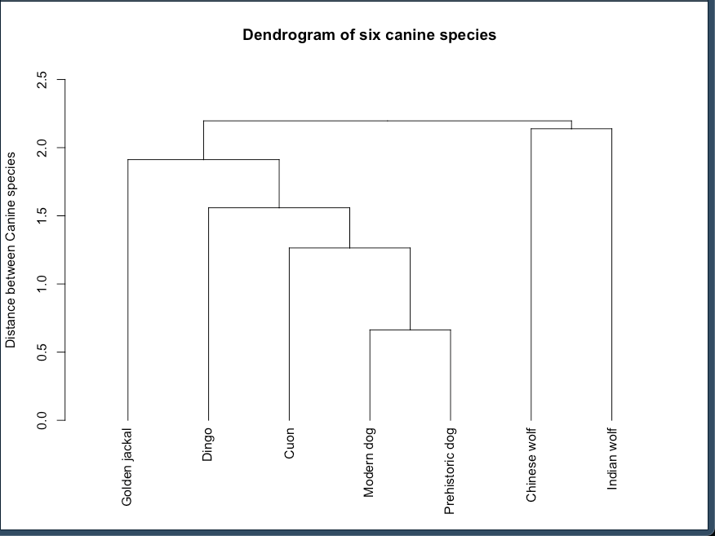
Cluster analysis
The cluster analysis was performed on the mean value dataset.
The results align with the principal components analysis and suggest that modern and prehistoric dogs are most related.

Slide 13
Conclusions and Notes
Based on our analysis, we can conclude that the prehistoric dogs are more closely related to modern Thailand village dogs.
Only relevant analysis are presented since Levene’s, Hotelling’s, Distance and more analysis were made but are not relevant to the presentation.

